Slide 1
Barack and Michelle Obama Academy
Notes:
Good Morning/Afternoon! Today we begin the process of planning our school’s budget for FY23. I know we are all here for the same reason and that is ensuring success for all (enter school name) students. This meeting is to provide an overview of the draft budget and for you to give feedback on the draft budget.

Slide 2
Norms
This is a meeting of the GO Team. Only members of the team may participate in the discussion. Any members of the public present are here to quietly observe.
We will follow the agenda as noticed to the public and stay on task.
We invite and welcome contributions of every member and listen to each other.
We will respect all ideas and assume good intentions.

Slide 3
GO Team Budget Development Process
YOUR SCHOOL STRATEGIC PLAN…
is your roadmap and your role. It is your direction, your priorities, your vision, your present, your future.
Step 1: Data Review
Step 2: Strategic Plan Review
Step 3: Budget Parameters
Step 4: Budget Choices
Notes:
Today I will provide an overview of the budget allocations for FY23. We will begin the work of funding the strategic priorities we agreed upon during our strategic review meeting. (IF YOU HAVE NOT DECIDED ON YOUR PRIORITIES, YOU WILL SAY – WE WILL DECIDE ON OUR PRIORITIES AND THEN DISCUSS ALLOCATING FUNDS TO ADDRESS THOSE PRIORITIES).

Slide 4
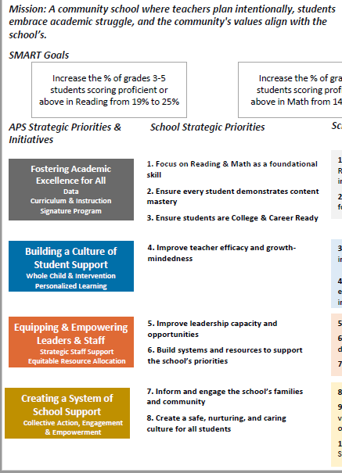
FY23 Budget Development Process
Principal’s Role
Design the budget and propose operational changes that can raise student achievement
Flesh out strategies, implement and manage them at the school level
Focus on the day-to-day operations
Serve as the expert on the school
Hire quality instructional and support personnel
The GO Team’s Role:
Focus on the big picture (positions and resources, not people)
Ensure that the budget is aligned to the school’s mission and vision and that resources are allocated to support key strategic priorities

Slide 5
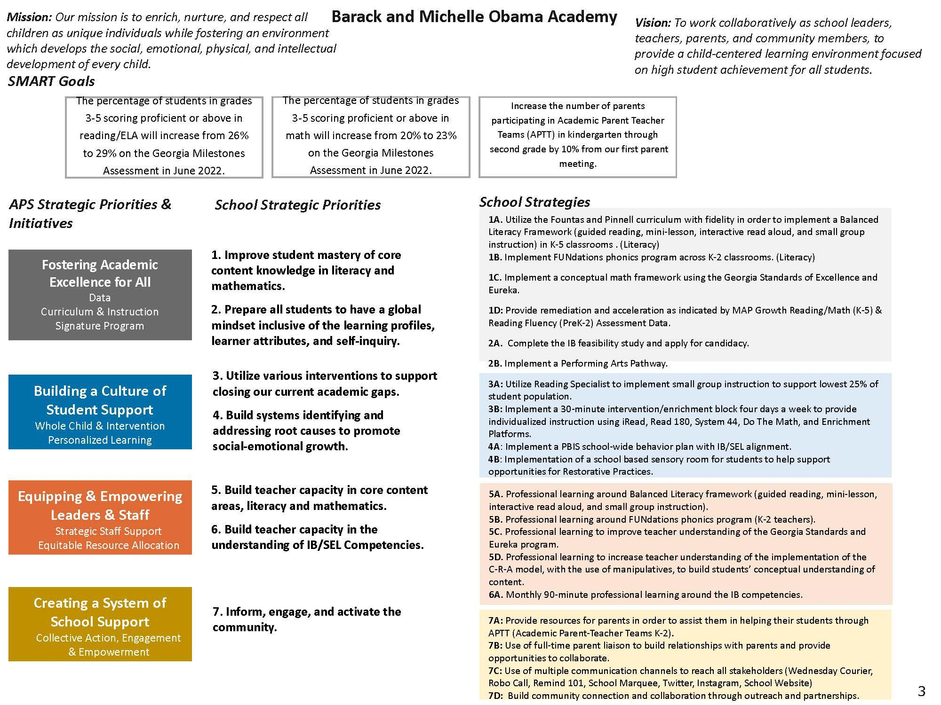
Barack & Michelle Obama Academy Strategic Plan
Notes:
You should have a copy of our updated strategic plan (please make copies to be distributed to team).

Slide 6
FY23 Priorities & SMART Goals
(From your Strategic Plan, insert your Top 2 Priorities & SMART Goals for FY23 here)
School Priorities
SMART Goals
Improve student mastery of core content knowledge in literacy and mathematics.
The percentage of students in grades 3-5 scoring proficient or above in reading/ELA will increase from 26% to 29% on the Georgia Milestones Assessment in June 2022.
The percentage of students in grades 3-5 scoring proficient or above in math will increase from 20% to 23% on the Georgia Milestones Assessment in June 2022.
(Note that goals will be adjusted once Milestones data is received for the 21-22 school year.)
Prepare all students to have a global mindset inclusive of the learning profiles, learner attributes, and self-inquiry.
The percentage of students in grades 3-5 scoring proficient or above in reading/ELA will increase from 26% to 29% on the Georgia Milestones Assessment in June 2022.
The percentage of students in grades 3-5 scoring proficient or above in math will increase from 20% to 23% on the Georgia Milestones Assessment in June 2022
Notes:
Discuss priorities and rationale

Slide 7
FY23 Budget Parameters
FY23 School Priorities | Rationale
Improve student mastery of core content knowledge in literacy and mathematics. | More than 50% of our students are still scoring at the beginning level in literacy and mathematics. Teachers need support in gaining a variety of targeted strategies to support small group instruction. Continued targeted support in this area is needed to support the growth of all students.
Prepare all students to have a global mindset inclusive of the learning profiles, learner attributes, and self-inquiry. | The school’s mission and vision speaks to the importance of educating the whole child. Students must have the opportunity to be exposed to the world around them. Teachers need support in facilitating learning that challenge students to think critically.
Notes:
Discuss priorities and rationale. After you have gone over the priorities and rationale – ask GO Team if this represents what was agreed upon.
Are there any priorities I left off?
Are there any questions or concerns?
The next time we meet, I will show you how I have allocated resources to support our strategic priorities.

Slide 8
Discussion of Budget Summary
(Step 4: Budget Choices)

Slide 9
Executive Summary
This budget represents an investment plan for our school’s students, employees and the community as a whole.
The budget recommendations are tied directly to the school’s strategic vision and direction.
The proposed budget for the general operations of the school are reflected at $4,632, 075
This investment plan for FY23 accommodates a student population that is projected to be 290 students, which is a increase/decrease of 5 students from FY22.
Notes:
Here’s a few highlights for our budget this year – read executive summary

Slide 10
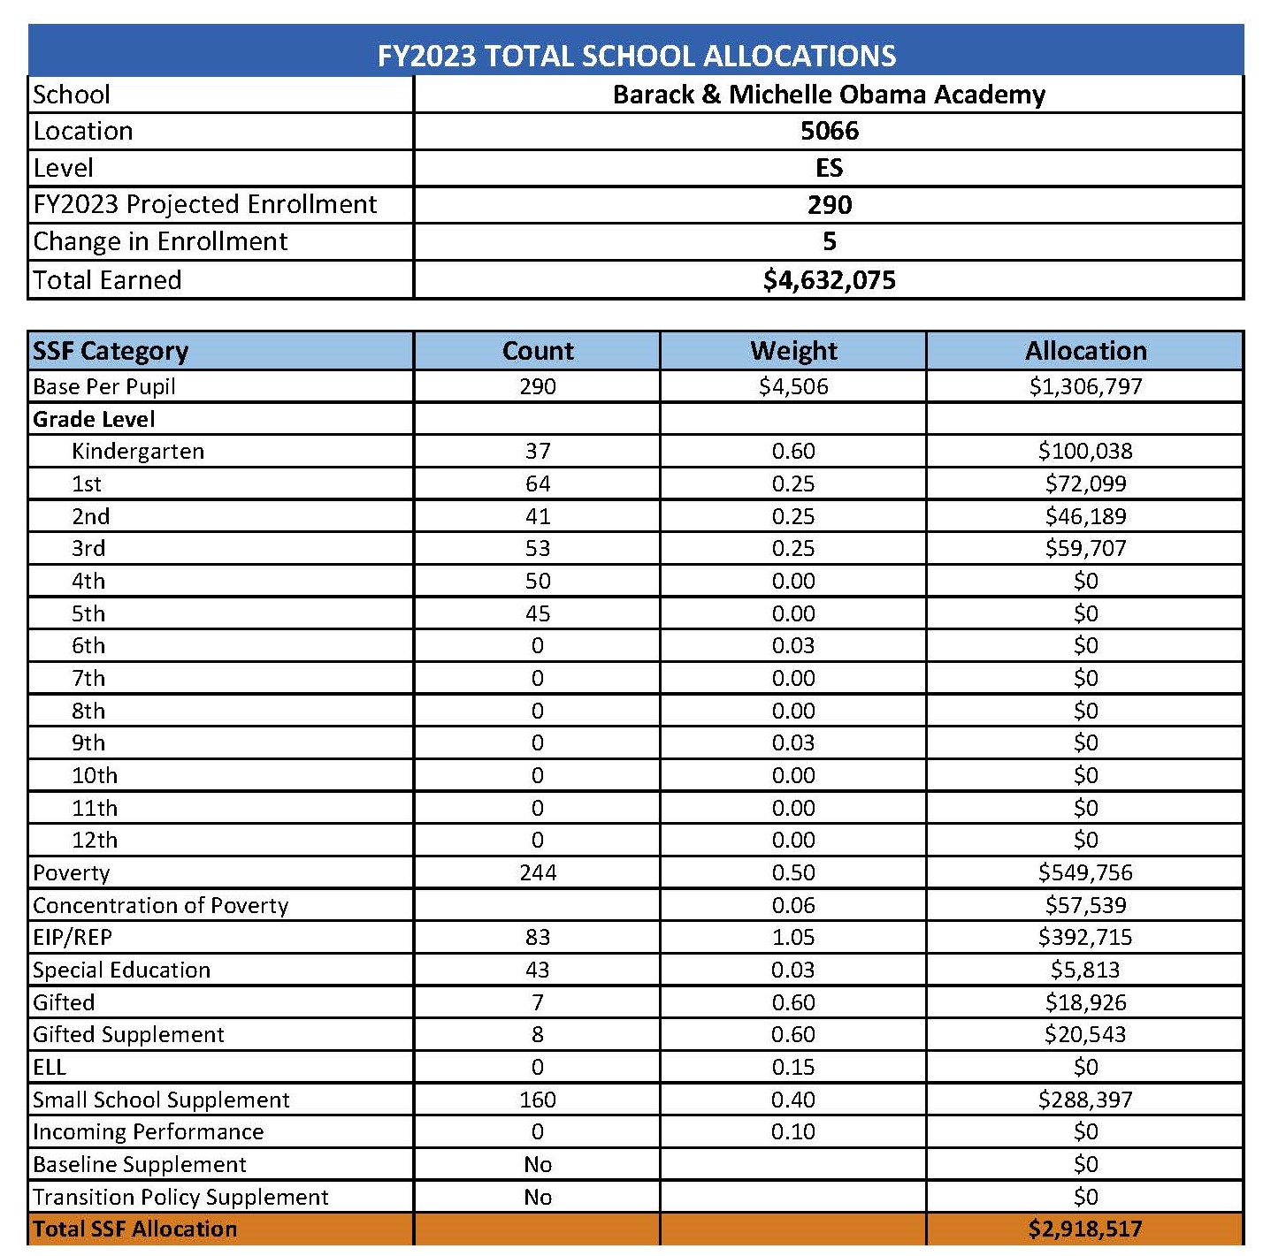
School Allocation
Notes:
For FY23, APS is continuing to increase equity within the District and the flexibility principals have in regards to our schools budgeted funds. The new Student Success Funding Model (SSF) allocates dollars to schools based on the number of enrolled students and receives a funding "weight" based on need. This year, student characteristics were weighted based on:
Grade Level –
K-12
Poverty – Weighted for all Direct Certification enrolled students.
Beginning Performance – Weighted Middle School and High School students entering with beginner’s performance on milestones.
ESOL – Weighted for all ESOL designated students in order to supplement due to ESOL staff being locked.
Special Education - Weighted for all Special Education students.
Gifted – Weighted and measured by number of students in the Gifted Program
Small School Supplement – Weighted for low enrollment schools
ES – 500
MS – 600
HS – 700
As you can see, our projected enrollment for FY23 is 290, we increased/decreased by 5 from last year.
We received the following weights for our student characteristics: (Below is just for the script, principals need to insert their school’s characteristics)
Grade Level
Poverty
Special Education
Gifted
Gifted Supplement
ELL
Small School Supplement

Slide 11
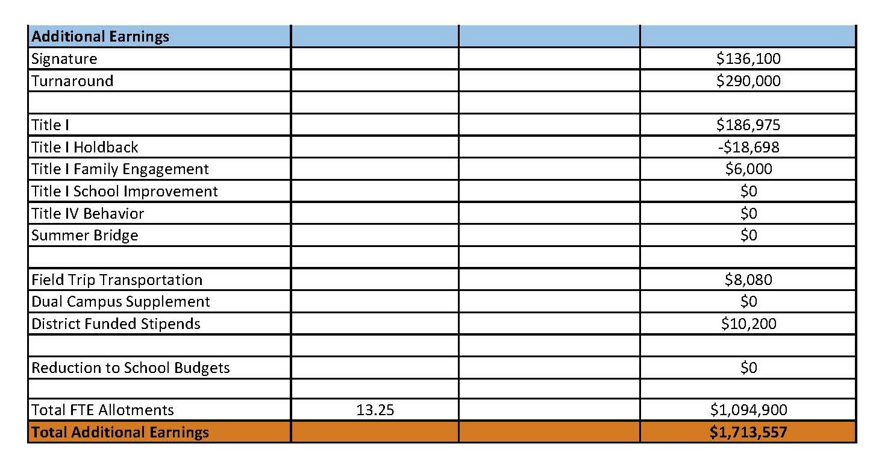
School Allocation
Notes:
Additionally, we received money for signature programming, turnaround, Title I and FTE Allotments.

Slide 12
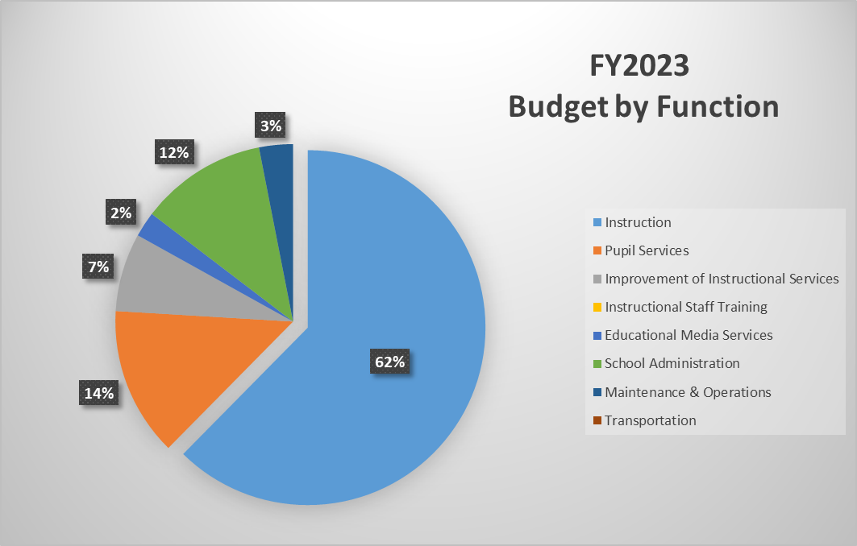
Budget by Function
Notes:
I am passing out the definitions for these funding categories. You will see what makes up each category. Although the school’s total budget amount will not change, allocation per function may change depending on our conversations and school needs.

Slide 13
School FY23 CARES Allocation
In addition to a General Fund allocation, our school has been allocated CARES funding that must be used to support implementation of the school-based intervention block and other school-based needs as a result of the COVID-19 Pandemic.
Once the support needed to implement our school-based intervention block/course has been fulfilled, we can use the remaining CARES funds to address other school-based needs that are a result of the COVID-19 Pandemic.
Notes:
Please add your school’s CARES Allocation to this slide.

Slide 14
CARES Allocations
Other allowable CARES expenditures include:
Technology Support: Software, assistive technology, online learning platforms, subscriptions.
Mental and Physical Health: Cover the costs of additional counseling, telehealth, therapeutic services, and wraparound services and supports (contracted hours, professional learning, programs)
Supplemental Learning: Cover costs of remediation, and/or enrichment opportunities during the school year for students (afterschool programs, additional pay for teachers and staff, transportation).
Professional Development: Cover costs of additional professional development for school leaders, teachers, and staff (trainings, extended professional development days, consultants, programs).
At-risk Student Populations: Cover costs of school specific activities, services, supports, programs, and/or targeted interventions directly addressing the needs of low-income students, students with disabilities, racial and ethnic minorities, English Learners, migrant students, students experiencing homelessness, and children in foster care.
Continuity of Core Staff and Services. Restore any potential LEA FY22 budget reductions due to decreased state and/or local revenue.

Slide 15
What’s Next?
January:
GO Team Initial Budget Session (Jan. 13th-early February)
February:
One-on-one Associate Superintendent discussions
Cluster Planning Session (positions sharing, cluster alignment, etc.)
Program Manager discussions and approvals
GO Team Feedback Session
HR Staffing Conferences (Late February - Early March)
• March:
Final GO Team Approval (AFTER your school’s Staffing Conference- March 18th)
Notes:
In February, we will meet again to discuss how the school’s budget has been allocated to support the programmatic needs and FY23 key strategic priorities.
If think we need to continue our budget conversations, we will schedule additional meetings. My goal is to make sure your voices are reflected in our school’s budget.
I will also be meeting with my Associate Superintendent, program managers and other key leaders to go over our budget and to make sure the school is meeting the standards of service and appropriately staffing.
During the week of Feb. 24th -March 2nd , HR Staffing Conferences will be held. At this meeting, I will present my plan for staff utilization, resource distribution and plan for staffing implications.
We will need to approve the budget at the ________ meeting.

Slide 16
Questions?
Thank you for your time and attention.
Notes:
IF YOU FEEL YOUR TEAM IS READY TO APPROVE THE DRAFT BUDGET, PLEASE DO SO. PLEASE REMIND THEM THAT YOU MAY NEED TO MEET WITH THEM AGAIN, IF THERE ARE CHANGES FROM YOUR MEETINGS WITH DISTRICT LEADERSHIP. LET THEM KNOW YOU WILL KEEP THEM INFORMED!!

Slide 17
Slides to Complete After Your GO Team’s Initial Budget Meeting and After You’ve Met with Your Associate Supt. And Program Managers
(Steps 3 and 4 in the GO Team Budget Process)

Slide 18
FY23 Budget Parameters
FY23 School Priorities | Rationale
Improve student mastery of core content knowledge in literacy and mathematics. (APS 5: Curriculum & Instruction) | More than 50% of our students are still scoring at the beginning level in literacy and mathematics. Teachers need support in gaining a variety of targeted strategies to support small group instruction. Continued targeted support in this area is needed to support the growth of all students.
Prepare all students to have a global mindset inclusive of the learning profiles, learner attributes, and self-inquiry. (APS 5: Signature Programming) | Students may have the opportunity to experience the world beyond the walls of our building. As stakeholders, we all play a role in equipping our scholars to be successful citizens in our community. Scholars who receive IB PYP at the elementary level are able to matriculate through the cluster.
Build teacher capacity in core content areas, literacy and mathematics. (APS 5: Curriculum & Instruction) | Teachers need ongoing to professional learning based around best practices for teaching our students. They also need the opportunity to gain new strategies to support the gaps in student learning.
Build teacher capacity in the understanding of IB/SEL Competencies. (APS 5: Signature Programming & Whole Child & Intervention) | The whole child must be part of the learning process within our building. We want to equip students to be able to be productive citizens in their community.
Utilize various interventions to support closing our current academic gaps. (APS 5: Whole Child & Intervention & Personalized Learning) | More than 50% of our school is below mastery in literacy and mathematics. We want to provide targeted programs, strategies, and personnel to support filling in these academic gaps.
Inform, engage, and activate the community. (APS 5: Interwoven throughout all domains) | It takes all stakeholder groups in the community to grow and reach our scholars. Expanding communication between stakeholder groups will allow for the needs of our scholars to be met.
Notes:
Review the priorities that the GO Team has developed and the rationale for these priorities

Slide 19
Description of Strategic Plan Breakout Categories
Priorities– FY23 funding priorities from the school’s strategic plan, ranked by the order of importance.
APS Five Focus Area- What part of the APS Five is the priority aligned to?
Strategies – Lays out specific objectives for schools improvement.
Request – “The Ask”. What needs to be funded in order to support the strategy?
Amount- What is the cost associated with the Request?

Slide 20
FY23 Strategic Plan Break-out
Priorities | APS FIVE Focus Area | Strategies | Requests | Amount
Improve student mastery of core content knowledge in literacy and mathematics . | Curriculum & Instruction, Whole Child & Intervention | Provide remediation and acceleration as indicated by MAP Growth Reading/Math (K-5) Reading Fluency (PreK-2)Assessment Data. | Add a Turnaround Math Specialist | $105, 151
Prepare students to have a global mindset inclusive of the learner attributes, and self inquiry. | Signature Programming | Support the Implementation of the IB programming. | Add a Signature IB Specialist | $106, 578
Notes:
For the next few slides, I will show you how I have allocated the budget to support our strategic priorities.
Based on our strategic priorities and funds we received, here is a break-out of the priorities, which focus area it addresses, the strategies that will be implemented, the purchase request, which funding source was used and the amount.

Slide 21
Plan for FY23 Leveling Reserve
Priorities | APS Five Focus Area | Strategies | Requests | Amount
Inform, engage, and activate the community. | Creating a System of School Support | Use of a full time Parent Liaison to build relationships with parents and provide opportunities to collaborate | Switch from an Hourly Parent Liaison to a Full Time Parent Liaison. | $26, 755
Build Teacher Capacities in the Understanding of IB/SEL Competencies. | Whole Child & Intervention, Signature Programming | Professional Learning around IB/SEL | Provide IB implementation training for staff | $10, 000
Prepare all students to have a global mindset inclusive of the learning profiles, learner attributes, and self inquiry. | Fostering Academic Excellence for All | Implement a Performing Arts Pathway | Add Hourly Dance Teacher | $21, 615
Notes:
This slides represent the priorities we will fund if we receive additional money from Title I and the Leveling Reserve. When we approve the budget we will approve both so that we will not have to schedule another meeting if the funds are made available.

Slide 22
Plan for FY23 Title I Holdback and Family Engagement Funds
Priorities | APS Five Focus Area | Strategies | Requests | Amount
Utilize Various interventions to support closing our current academic gaps. | Building a Culture of Student Support | Implement a 30 minute intervention intervention/enrichment block 4 days a week to provide individualized instruction | Add Teacher Tutors | $18,698
Notes:
This slides represent the priorities we will fund if we receive additional money from Title I and our Family Engagement funds. When we approve the budget we will approve both so that we will not have to schedule another meeting if the funds are made available.

Slide 23
Plan for FY23 CARES Allocation
Priorities | APS Five Focus Area | Strategies | Requests | Amount
Improve student mastery of core content knowledge in literacy and mathematics. | Fostering Academic Excellence for All | Provide Remediation and acceleration as indicated by MAP Growth Reading/Math K-5 & Reading Fluency . | (3) Paraprofessionals at Grades 3-5 (1.0 FTE) | $131, 096
Build systems identifying and addressing root causes to promote social-emotional growth. | Building a Culture of Student Support | Implement a PBIS school wide behavior plan with IB/SEL Alignment | Full Time Counselor (.5 FTE) | $41,925
Build systems identifying and addressing root causes to promote social-emotional growth. | Building a Culture of Student Support | Implement a PBIS school wide behavior plan with IB/SEL Alignment | Student Incentives | $5410
Notes:
This slide represents the priorities we will fund during FY23 with our CARES 3 allotment.
Before I turn it back over to the Chair for the next slide, I want to thank you for your hard work and support this year. I will keep you informed as we move through the budget process. (Please inform Chair that they will facilitate the discussion for the last slide)

Slide 24
Questions for the GO Team to Consider
Are our school’s priorities (from your strategic plan) reflected in this budget?
Are new positions and/or resources included in the budget to address our major priorities?
Do we know (as a team) the plan to support implementation of these priorities beyond the budget (ex. What strategies will be implemented)?
What tradeoffs are being made in order to support these priorities?
2. How are district and cluster priorities reflected in our budget?
Cluster priorities- what staff, materials, etc. are dedicated to supporting our cluster’s priorities?
Signature programs- what staff, materials, etc. are dedicated to supporting our signature program?
Are there positions our school will share with another school, i.e. nurse, counselor?
Notes:
CHAIR - Our final task for today! Here are questions that we need to consider to ensure we have a good working draft budget. Let’s walk through them together.

